Slide 1
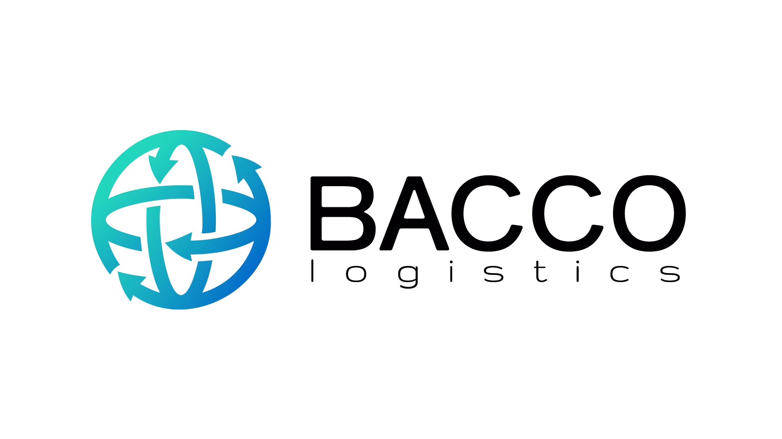

Your Trusted Logistics Partner !

Slide 2
Agenda
1. Company presentation
2. Logistics solutions and services
3. Partner network and market coverage
4. Operational efficiency and reliability
5. Benefits for business partners
6. Cooperation opportunities
7. Contact information

Slide 3
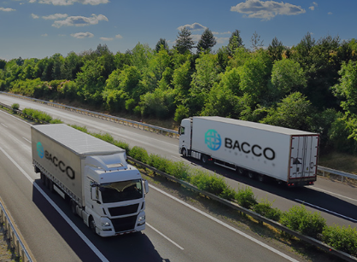
Company presentation
Bacco Logistics is an international logistics company headquartered in Stuttgart, Germany, with an operational office in Belgrade, Serbia.
We specialize in organizing international transport and logistics solutions that connect European and global markets. Our goal is to provide clients with reliable, flexible, and cost-effective logistics support tailored to their business needs.
By combining local market expertise with an international network of transport partners, we enable efficient movement of goods across Europe and Asia

Slide 4
Logistics solutions and services
🚛 Road Transport
FTL and LTL transport
Distribution of goods across Europe
Direct and consolidated shipments
🛳️ Sea Freight
FCL and LCL shipments
Import and export of goods from Asia and other global markets
Organization of the entire transport process
✈️ Air Transport
Urgent and time-sensitive shipments
International cargo transport on a global scale
Door-to-door logistics solutions
🗺️ Logistics Coordination
Transport planning
Shipment tracking
Communication with all supply chain participants
Optimization of transport costs

Slide 5
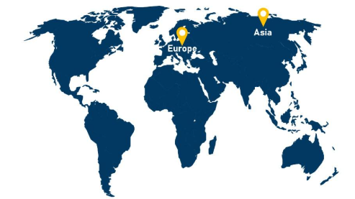
Partner network and market coverage
Our focus is on connecting key European and Asian markets.
Key markets
Germany
Austria
Serbia
Western Balkan countries
China
Regions we cover
Central Europe
Southeast Europe
Western Balkans
Asia
Thanks to our international network of carriers and logistics partners, we are able to organize transport between a wide range of European and global destinations.

Slide 6
Operational efficiency and reliability
Our business model is based on flexibility and the selection of the optimal transport solution for each individual request.
We provide our clients with:
⏱️ Fast handling of inquiries
🤝 Transparent communication
🌐 Shipment tracking throughout the entire process
📊 Optimization of costs and transit times
🧑‍💻 Dedicated support at every stage of transport
Our focus is not only on the transportation of goods, but also on building long-term business relationships based on trust and reliability.

Slide 7

Benefits for business partners
Why collaborate with Bacco Logistics?
✓ International presence through offices in Germany and Serbia
✓ Flexible logistics solutions tailored to client needs
✓ Access to European and Asian markets
✓ Fast and direct communication
✓ Individual approach to each project
✓ Focus on service quality and long-term cooperation
Relevant experience
We have successfully participated in logistics projects and transport operations for companies such as:
Aramex
Tekpoint GmbH
eMAG GmbH
Adam Hall GmbH
Homeon Inc.
Gingerpaw SG PTE
JMJ Global GmbH

Slide 8
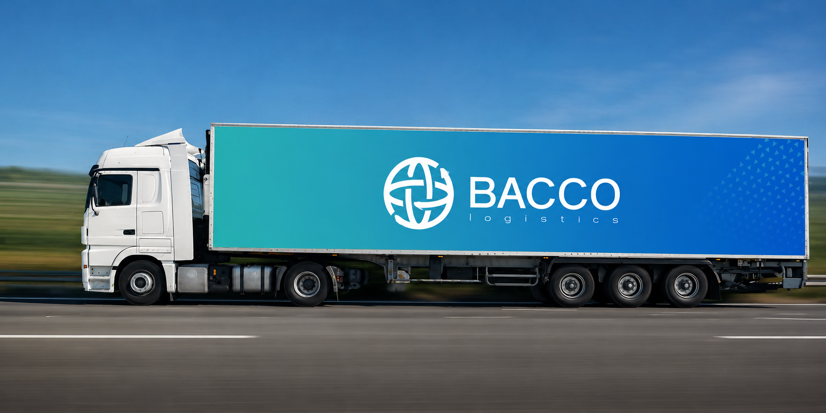
Cooperation opportunities
We are open to cooperation with:
Transport companies
Freight forwarding companies
Importers and exporters
Distributors
E-commerce companies
Manufacturing companies
We are looking for long-term business partners with whom we can develop stable and mutually beneficial logistics projects in the European and international markets.

Slide 9
Contact information
Operations Office:
Balkanska 35–39
11000 Belgrad, Serbien
E-mail: info@bacco-logistics.com
Phone: +381112646292
Head Office:
Luftfrachtzentrum, Gebäude 60512
70629 Stuttgart, Deutschland
Website: www.bacco-logistics.com
LinkedIn: www.linkedin.com/in/bacco-logistics-308а17417
Facebook: https://www.facebook.com/profile.php?id=61591188500216

Slide 10

Connecting Markets. Delivering Solutions.
Road Freight • Air Freight • Ocean Freight

Slide 11
Thank you !
IGOR CVETKOVIC
+381112646292
i.cvetkovic@bacco-logistics.com
www.bacco-logistics.com

